Slide 1
NBA DATABASE
CSC 455
Alejandra
Krista
Shaik

Slide 2
BRIEF DESCRIPTION
This NBA database website provides end users with a new website where they can access data about their favorite players or teams, and browse through merchandise for NBA teams.

Slide 3
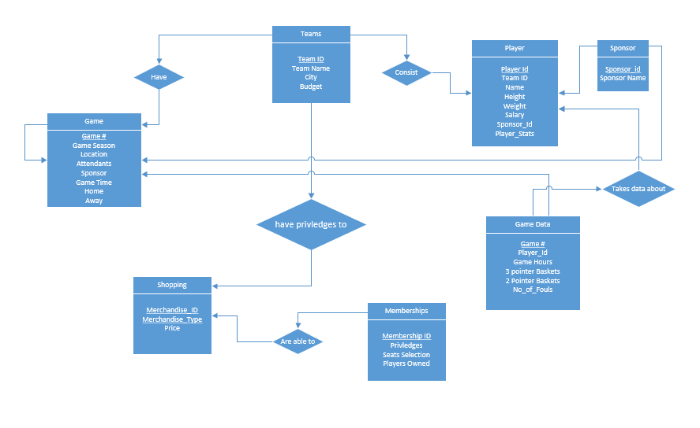
E-R DIAGRAM

Slide 4
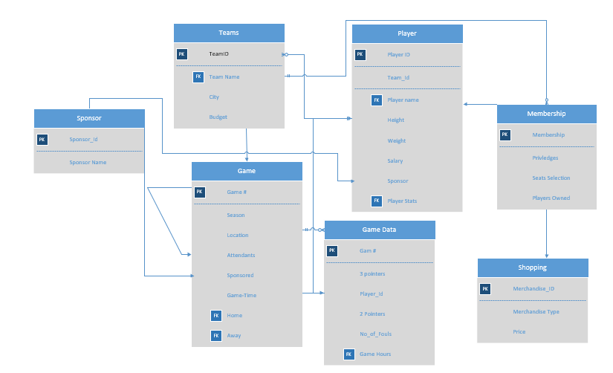
RELATIONAL SCHEMA

Slide 5
Normalization
1NF
2NF
3NF
BCNF

Slide 6

DEMONSTRATION
Back – end -> SQL
Front – end -> PHP

Slide 7
WHAT WE LEARNED
Teamwork
Creating a front-end website using Php with SQL backend.
Always have a contingency plan
What surprised us?
The learning curve for actually connecting databases to front-end.

Slide 8
Lessons Learned
Originally, before Covid-19 the project would have probably been a little easier since we could actually meet and discuss portions and make sure everything was getting done in a timely manner.
If we had the semester to do over and the project to restart, we would probably get started on actually implementing our ideas and developing. We may have even chosen a different topic to do our project on.

